Slide 1

Data Science Course

Slide 2

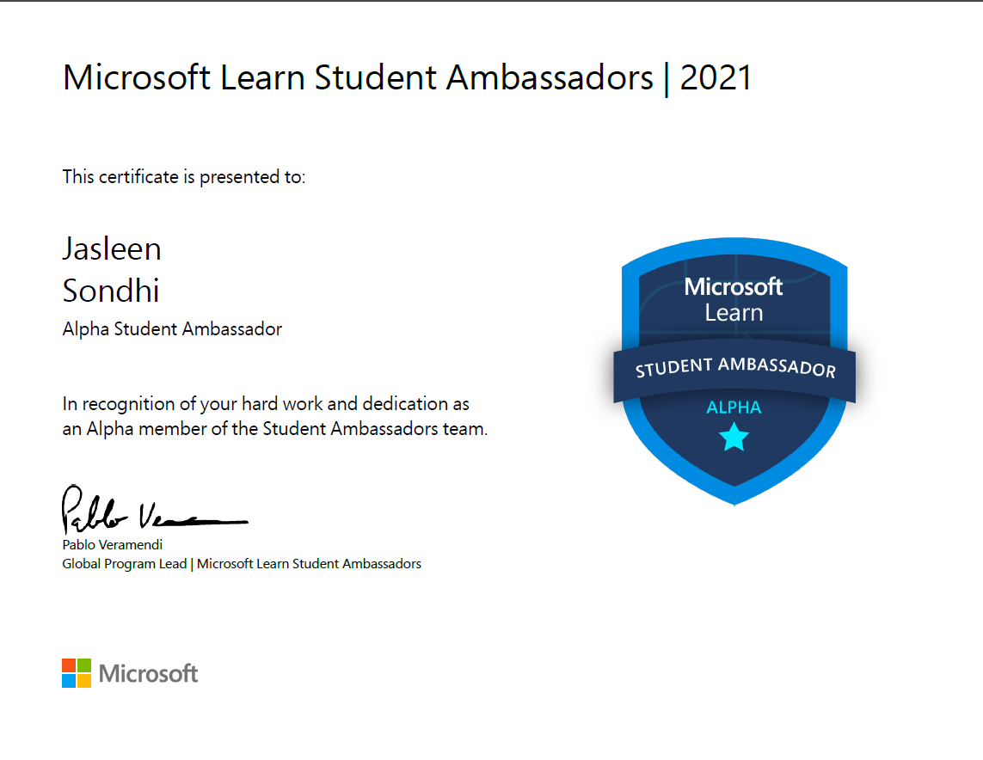


Jasleen Kaur Sondhi
R Programming Textbook Companion under publication process by IIT Bombay, FOSSEE Fellowship.
Microsoft Learn Student Ambassador
Campus Ambassador at GirlScript Bangalore
Final year student pursing triple majors in Physics, Mathematics and Computer Science, Mount Carmel College, Bangalore.
Certified by Duke University in Data Science Math Skills
@jasleen_sondhi
@jasleen101010

Slide 3

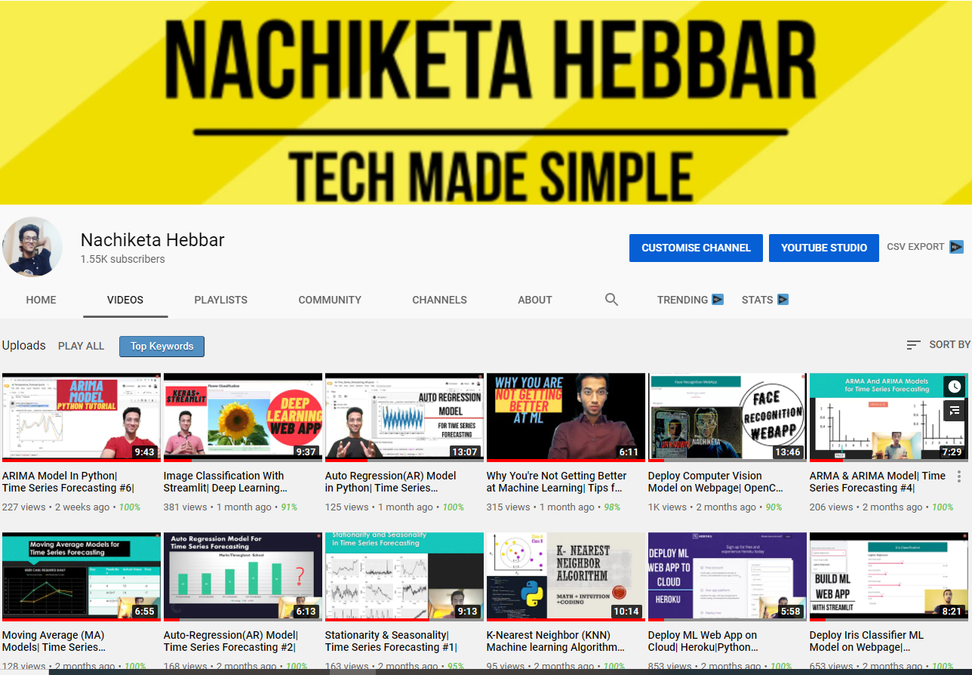

Nachiketa Hebbar
Youtuber (Teaching AI for 1.5+ years)
Former Data Science Intern at Arbunize
Former IT Intern at Maruti Suzuki
2 Published Research Papers in data science domain at IEEE and IJLTEMAS
Medium Data Science Writer
Speaker at Multiple AI and IoT Workshops
Senior Technical Advisor at the Indian Society for Technical Education
Microsoft Student Partner
Final year ECE Undergrad at VIT Vellore
Youtube.com/NachiketaHebbar
@nachihebbar
@nachi_hebbar

Slide 4
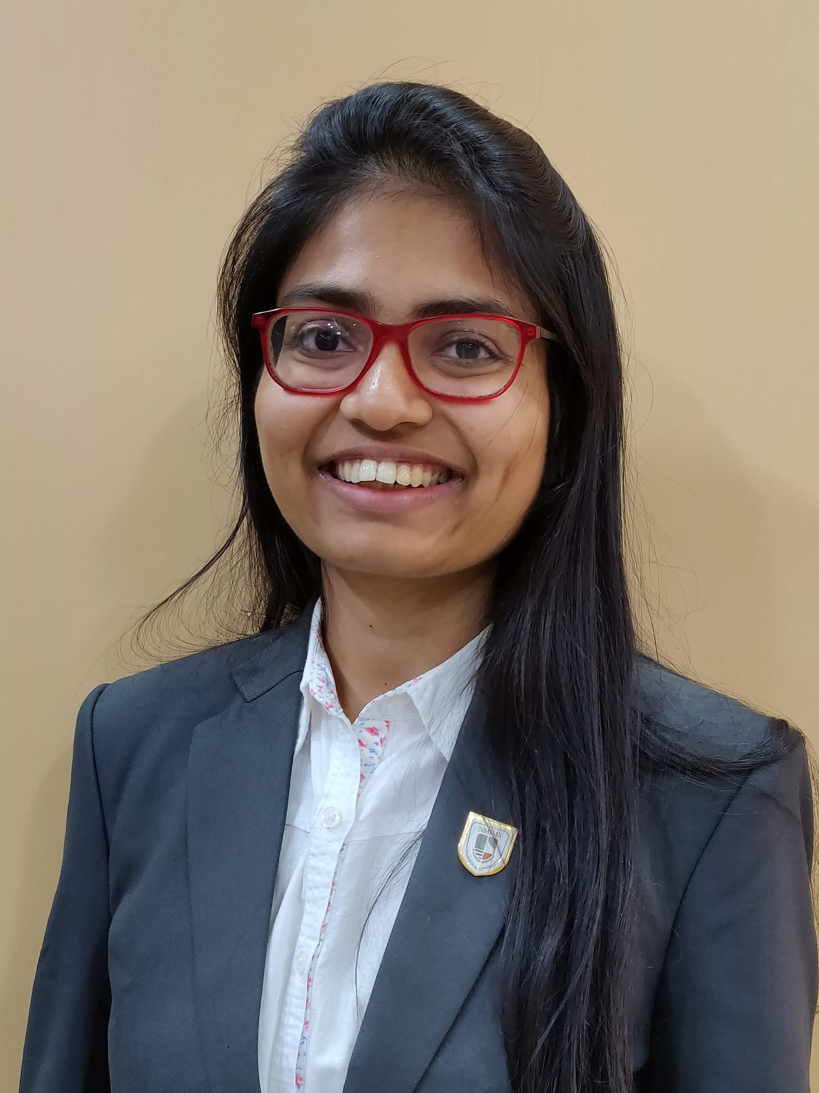
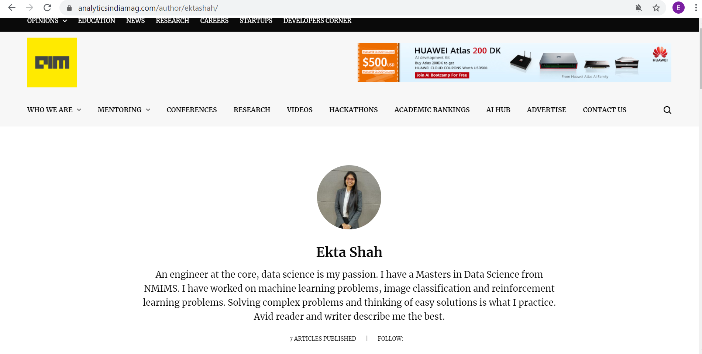
Ekta Shah
3 years + of industry work experience
Passionate about Data Science research
Data Scientist at Viacom 18 - working for Voot Select
Masters in Data Science from NMIMS university
Data Science Intern at General Mills and Mactores
Software Developer at BNP Paribas India Solutions
Conducts workshops and webinars on Python, Machine Learning
Writer at Analytics India Magazine
Expert Lecturer for Financial Analytics at colleges
Mentor at Data Science Hackathons
Research paper published in IJCA for License Plate Recognition System
Ekta-shah30
@Ekta_Shah

Slide 5
Course Overview
Introduction to Data Science
Applications
Python for Data Science from Scratch
Popular libraries for data processing : NumPy and Pandas
Basic Statistics : Linear Algebra, Calculus
Overview of the complete data science life cycle
Machine learning :Supervised and Unsupervised Learning Algorithms
Machine learning projects on Kaggle datasets
Model Performance and Evaluation
Time Series Models
Model Web App and Deployment

Slide 6
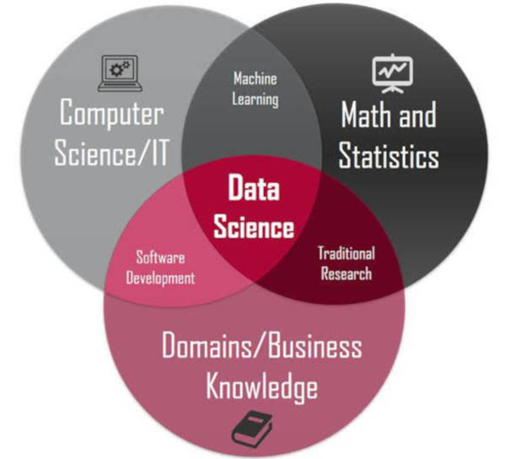
What is Data Science?
Data science, in its most basic terms, can be defined as obtaining insights and information, really anything of value, out of data.

Slide 7
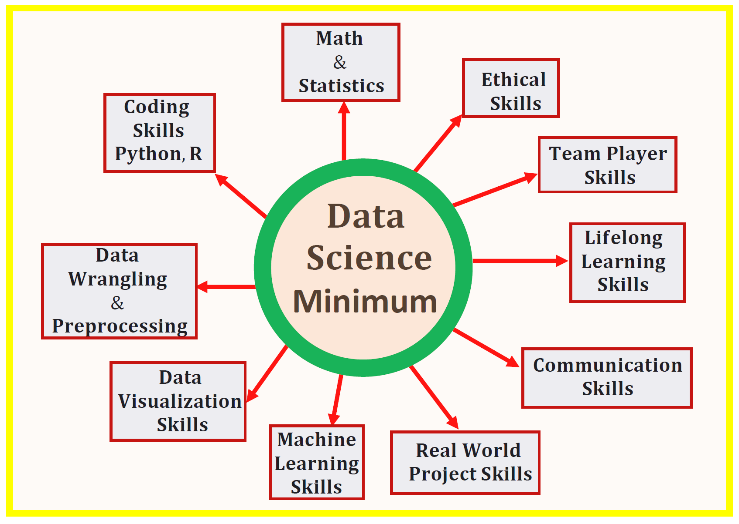
Who is a Data Scientist?
Data Scientist is someone who practices Data Science. They draw a lot of information from the scientific fields and applications whether it is statistics or mathematics.

Slide 8
What do Data Scientists do?
Identifying the data-analytics problems that offer the greatest opportunities to the organization
Determining the correct data sets and variables
Collecting large sets of structured and unstructured data from disparate sources
Cleaning and validating the data to ensure accuracy, completeness, and uniformity
Devising and applying models and algorithms to mine the stores of big data
Analyzing the data to identify patterns and trends
Interpreting the data to discover solutions and opportunities
Communicating findings to stakeholders using visualization and other means

Slide 9
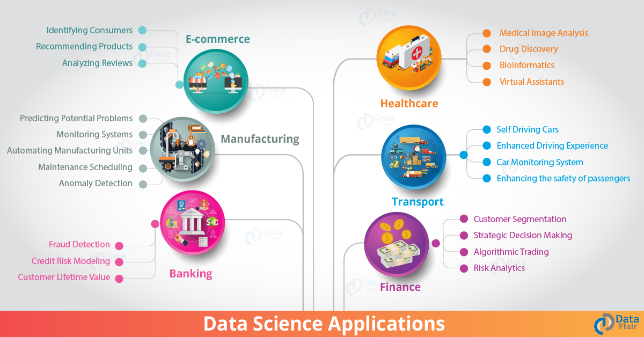
Applications of Data Science

Slide 10
Job Opportunities in Data Science
Some of the prominent Data Scientist job titles are-
Data Scientist
Data Engineer
Data Architect
Data Administrator
Data Analyst
Business Analyst
Data/Analytics Manager
Business Intelligence Manager

Slide 11
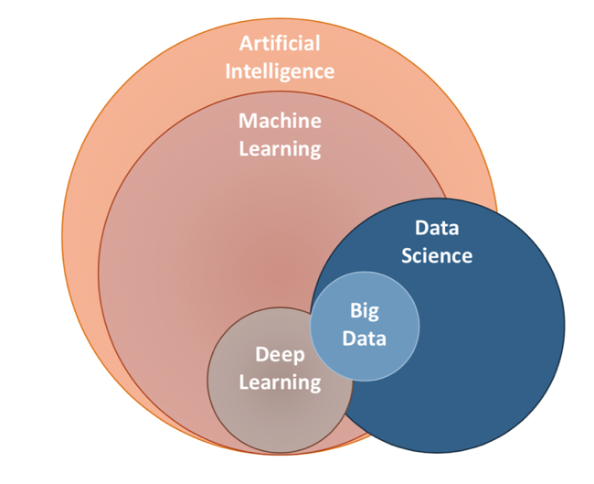
How does Machine Learning Come into Data Science?

Slide 12
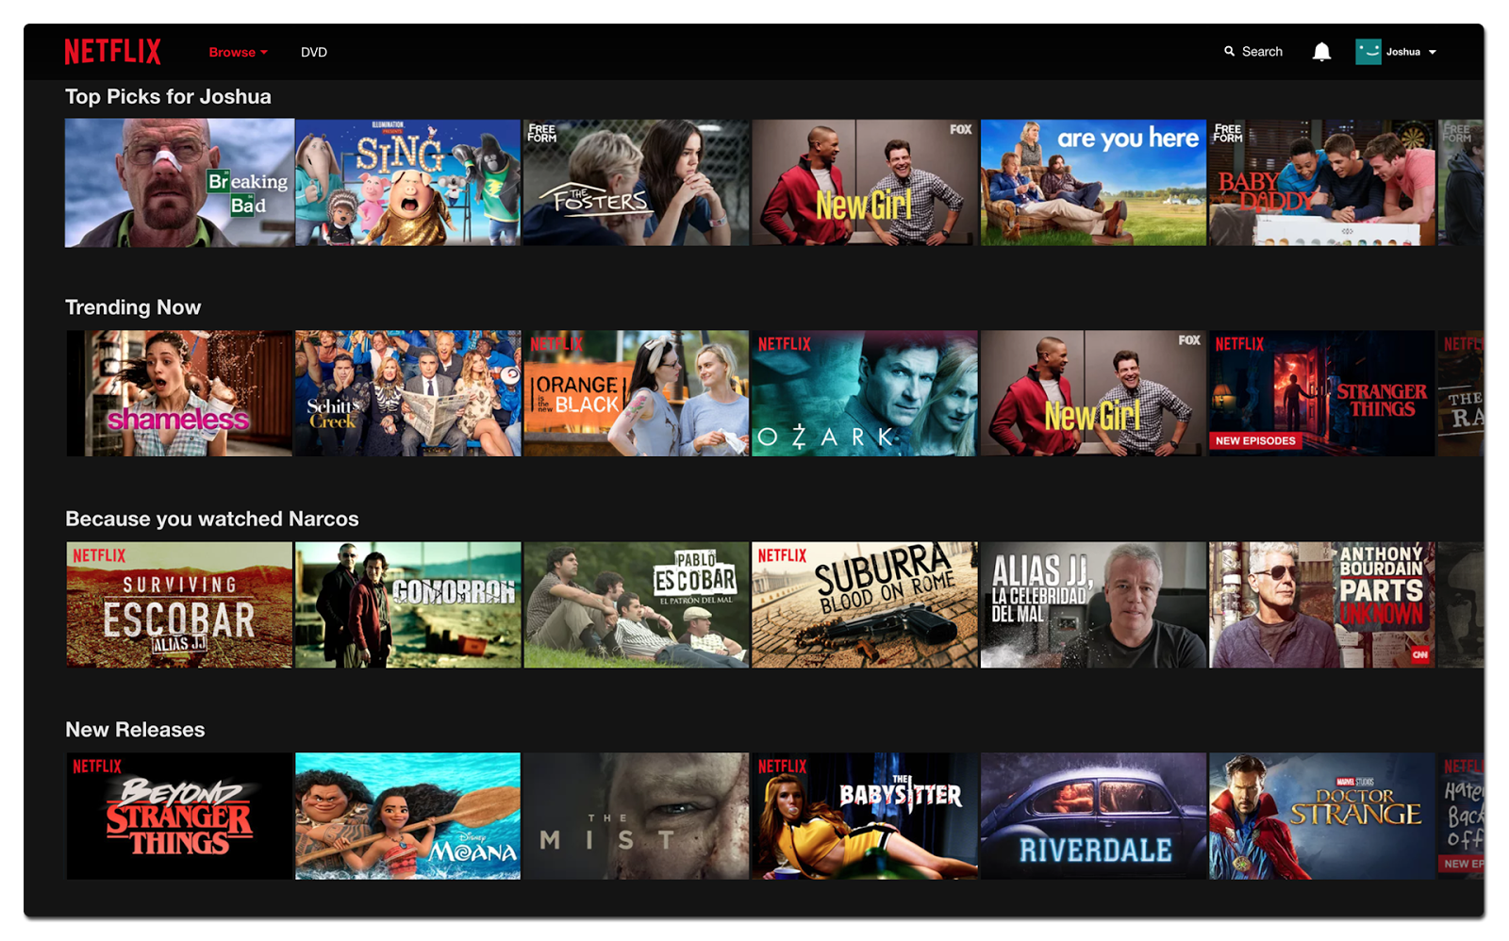
Where is Machine Learning used ?

Slide 13
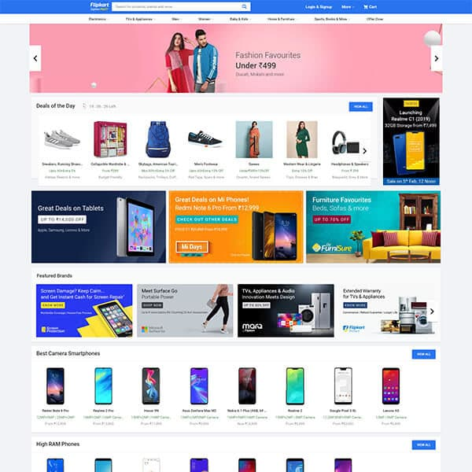
Where is ML Used ?
ALL Online shopping websites

Slide 14
So, What is Machine Learning Exactly?
Wikipedia Definition : “Machine learning involves computers discovering how they can perform tasks without being explicitly programmed to do so. Machine learning (ML) is the study of computer algorithms that improve automatically through experience “

Slide 15
More Simpler and Logical definition
Machine Learning
It’s just glorified geometry !
Simply, Learning from Data

Slide 16
Okay, then how does a ML Model exactly Work ?
Learning Algorithm
Predictions(Like Weather Analysis)
DATA(Lots and lots of it)
ML MODEL
Understand Patterns in data

Slide 17
To Master Machine Learning -> Master the Learning Algorithms
Learning Algorithm
Supervised Learning
Unsupervised Learning
Reinforcement Learning

Slide 18

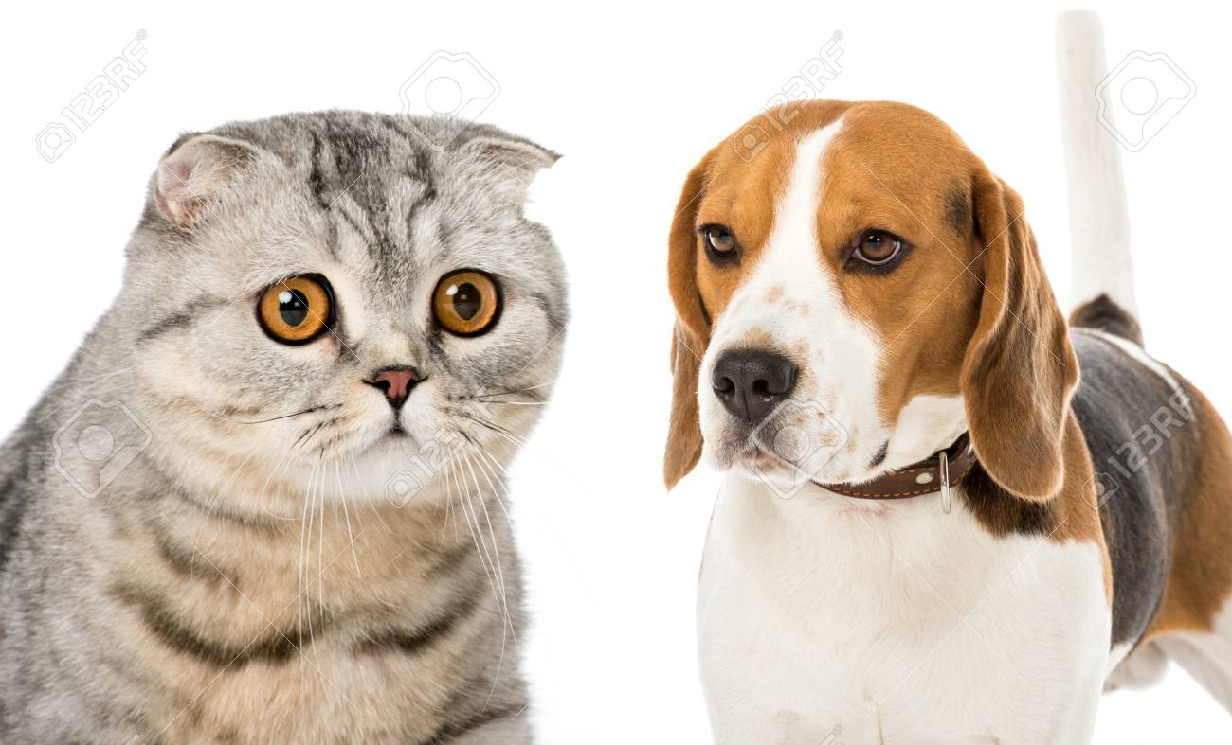

Let’s start with Supervised Learning
-Learning With Supervision
Supervised Learning Algorithm
Data
This is a cat !
ML MODEL
This is a dog !
CAT
DOG

Slide 19
Unsupervised Learning
-Learning without Supervision
Unsupervised Learning Algorithm
Data
This is different!
ML MODEL
This is different !

Slide 20
Reinforcement Learning
-Simply put , Reward Based Learning
-Example , a game of chess
Certain desirable states have higher rewards , while other have low rewards

Slide 21
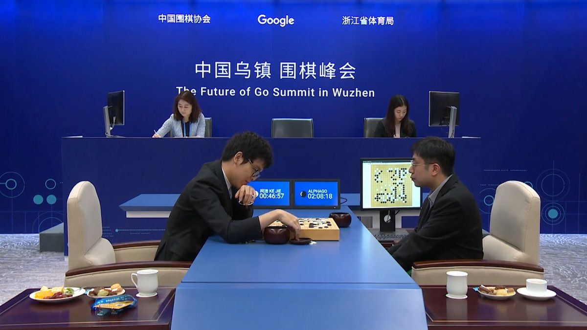
Alpha Go- Best example of reinforcement learning
Defeated world champion at Go

Slide 22
Problem 1
AN AD AGENCY IS TRYING TO SEND OUT ADS ON FACEBOOK TO PROMOTE ITS PRODUCTS. HOWEVER IT HAS NO CLUE SO AS TO WHICH AD TO SEND OUT TO WHOM.
FACEBOOK GIVES THE AGENCY A LIST OF ALL THE PEOPLE REGISTERED ON FACEBOOK AND INFORMATION LIKE AGE,GENDER,LOCATION,ETC
WHAT MACHINE LEARNING ALGORITHM SHOULD THE AGENCY USE ?

Slide 23
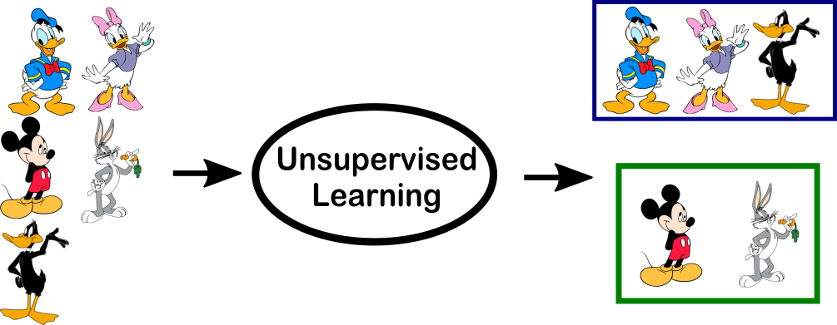
Answer – Unsupervised Learning

Slide 24
Problem 2
YOU HAVE TO TRAIN A ROBOT TO PLAY BASKETBALL OR SIMPLY THROW SHOTS IN IT.
PROBLEM IS YOU DON’T KNOW THE CORRECT ANGLE OR FORCE AT WHICH THE BALL SHOULD BE THROWN BEFORE HAND.
WHAT ALGORITHM DO YOU USE TO TRAIN THE BOT ?

Slide 25
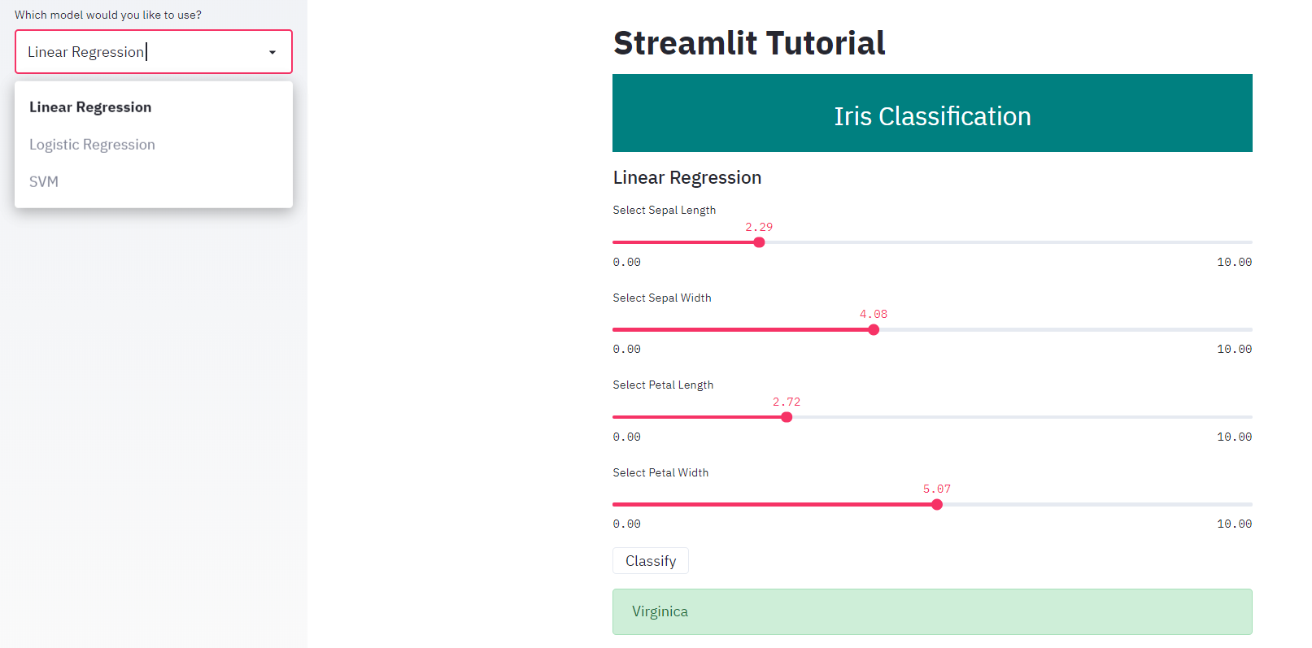
Applications you will be able to build after the course
Machine learning web apps for real world problems

Slide 26
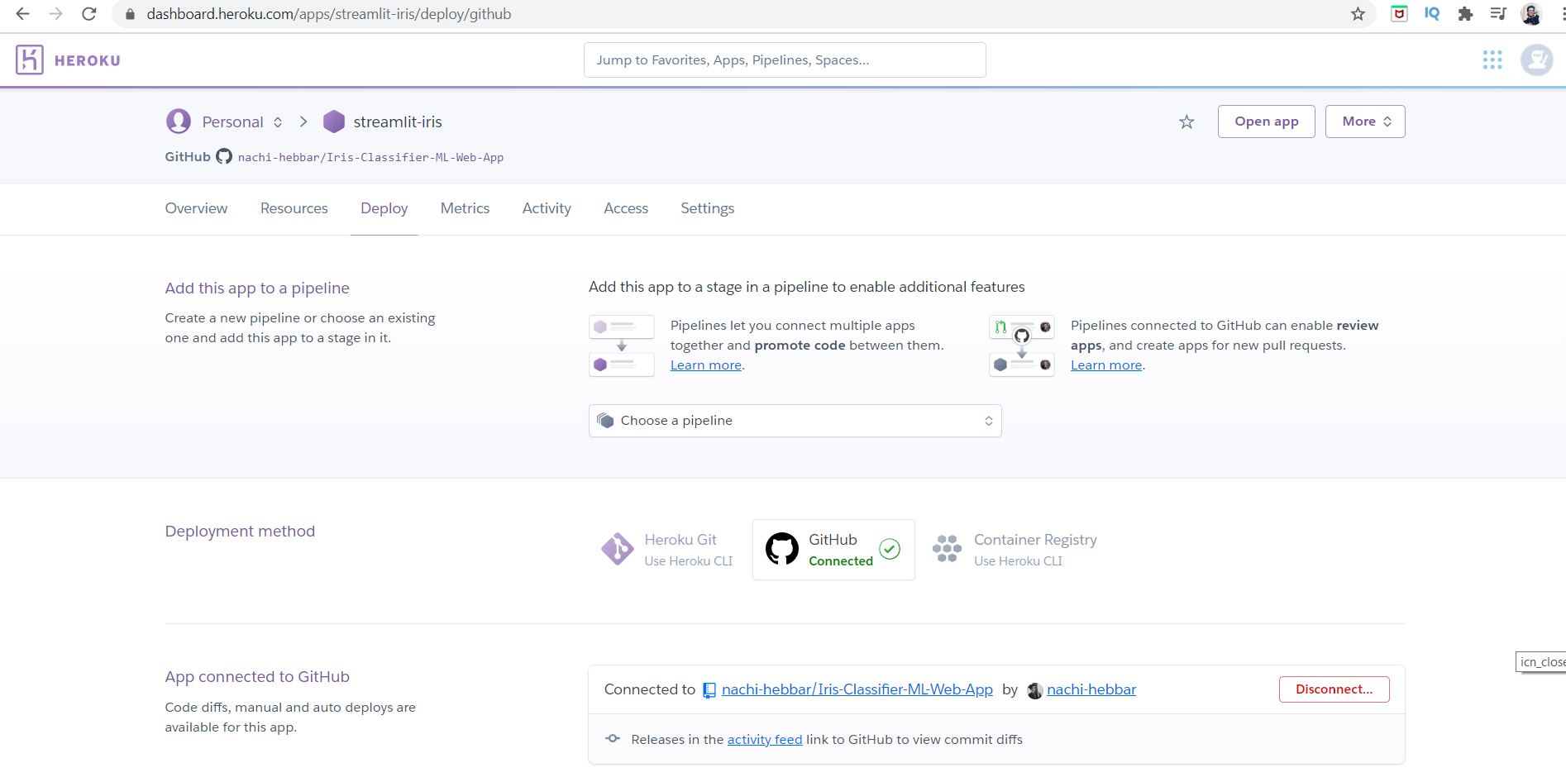
Applications you will be able to build after the course
Cloud deployment of models you build

Slide 27
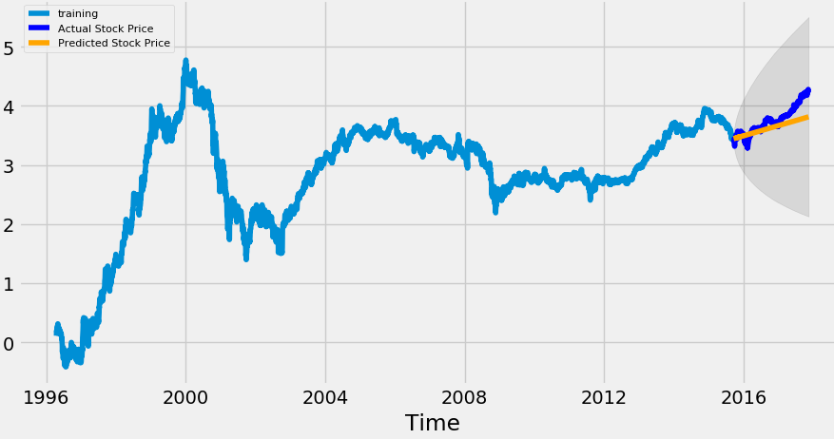
Applications you will be able to build after the course
Time Series Models

Slide 28
Why you should enroll?
Live mentoring sessions
Live doubt sessions
Project and assignments to build your skills
Learn and build models hands-on in each session
Get guidance from student and professional mentors

